Slide 1



SMART INDIA HACKATHON 2024
- **Problem Statement ID – SIH1620**
- **Problem Statement Title - Queuing models in OPDs/ availability of beds/ admission of patients. A hospital based solution is ideal which can be integrated with city wide module .
-Theme - MedTech / BioTech / HealthTech
- PS Category - Software
- Team ID -
- Team Name (Registered on portal) - THE SIxX
by Likith chowdary

Slide 2


Proposed Solution
Dynamic Queuing System
implements a time-series forecasting model (e.g., Prophet) to predict patient inflow and optimize queuing in OPDs.
Bed Availability Prediction
uses IoT devices and predictive analytics (classification models) to monitor and forecast bed occupancy in real time.
Automated Patient Admission
prioritizes patients based on severity using classification models
Inventory Management
Predicts medicine and consumable demand through demand forecasting models and automates stock replenishment.

Slide 3


THE SIxX
1
Minimizes Patient Wait Times
The solution will greatly benefit hospital staff, administrators, and patients by reducing wait times, optimizing resource allocation, and enhancing patient care. It will enable hospitals to function more efficiently and improve patient satisfaction.
2
Ensures Efficient Bed Utilization
The solution will greatly benefit hospital staff, administrators, and patients by reducing wait times, optimizing resource allocation, and enhancing patient care. It will enable hospitals to function more efficiently and improve patient satisfaction.
3
Improves Admission Process
The solution will greatly benefit hospital staff, administrators, and patients by reducing wait times, optimizing resource allocation, and enhancing patient care. It will enable hospitals to function more efficiently and improve patient satisfaction.
4
Reduces Inventory Shortages
The solution will greatly benefit hospital staff, administrators, and patients by reducing wait times, optimizing resource allocation, and enhancing patient care. It will enable hospitals to function more efficiently and improve patient satisfaction.

Slide 4
TECHNICAL APPROACH
PROGRAMMING LANGUAGES
FRAMEWORKS
VISUALIZATION/DEPLOYMENT
NUMPY/PANDAS
PYTHON
TENSORFLOW/KERAS
POWER BI
HTML
FLASK
IOT SENSORS
CSS
PROPHET
CLOUD SERVER ( AZURE)
JAVASCRIPT

Slide 5

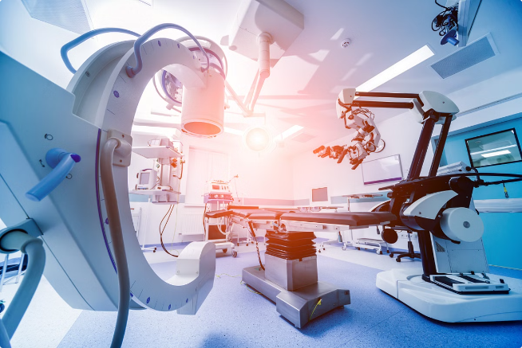
TECHNOLOGICAL STACK /FEASIBILITY AND VIABILITY
🖥️ Front-End:
HTML 🌐
CSS 🎨
JavaScript ⚙️
🖥️ Back-End:
Python 🐍
Flask 🌶️
🗄️ Database:
MongoDB Atlas 🍃
🔄 Integration:
APIs 🌐
WebSockets 📡
📊 Data Analytics:
Python Libraries 📈
🔒 Security:
SSL/TLS Encryption 🔐
Authentication and Authorization 🔑

Slide 6





IMPACT AND BENEFITS
Social
Improved patient care and reduced wait times lead to better healthcare outcomes and experiences.
Economic
Enhanced efficiency reduces operational costs, minimizes resource waste, and optimizes staff utilization.
Environmental
Efficient inventory management cuts down wastage of medical supplies and consumables, promoting sustainable hospital operations.

